Slide 1
Employee Data Analysis using Excel
STUDENT NAME:G.Sangeetha
REGISTER NO:312204249
DEPARTMENT:B.com(Accounting &Finance
COLLEGE:AnnaViolet Arts and Science college

Slide 2
PROJECT TITLE
Employee Performance Analysis using Excel
Salary and compensation analysis through data modeling

Slide 3


AGENDA
Problem Statement
Project Overview
End Users
Our Solution and Proposition
Dataset Description
Modelling Approach
Results and Discussion
Conclusion
3/21/2024 Annual Review

Slide 4

PROBLEM STATEMENT
1. Definition: Clearly articulate the problem.
2. Context: Provide relevant background information.
3. Impact: Explain the consequences or effects.
4. Goals: Outline desired outcomes or objectives.
5. Scope: Define boundaries and limitations.

Slide 5

PROJECT OVERVIEW
Annual salary information including gross pay and overtime pay for all active, permanent employees of Montgomery County, MD paid in calendar year 2023. This dataset is a prime candidate for conducting analyses on salary disparities, the relationship between department/division and salary, and the distribution of salaries across gender and grade levels.
.

Slide 6

WHO ARE THE END USERS?
The end users of salary and compensation analysis through data modeling are business executives, who can use the information to ensure that a system meets business needs

Slide 7

OUR SOLUTION AND ITS VALUE PROPOSITION
Salary benchmarking gives an impartial idea of competitive salaries and allows organizations to make informed decisions. Salary benchmarks provide data points, whether it is worth it or not to pay an employee above the average salary. It also helps understand the holistic remuneration packages offered by employers.

Slide 8
Dataset Description
The dataset used in this analysis comprises anonymized data on data science salaries collected from various sources, including surveys, job postings, and public records. It includes information on salary, education level, years of experience, job title, location, and more. By analyzing this dataset, we aim to uncover patterns and insights that can help professionals make informed decisions regarding their careers and organizations optimize their hiring and compensation strategies.

Slide 9

THE "WOW" IN OUR SOLUTION
Fact-based decision-making: Data analytics provides accurate and reliable information to help organizations make informed decisions about their compensation strategy. By analyzing data, organizations can identify compensation trends, evaluate the effectiveness of their compensation programs, and make data-driven decisions about their compensation strategy.
3/21/2024 Annual Review
9

Slide 10
MODELLING
Salary Benchmarking: Regression models can be used to benchmark salaries against industry standards and market trends. By analyzing compensation data from similar organizations or industry surveys, regression analysis helps organizations ensure their salary levels remain competitive.24 Apr 2024
10

Slide 11
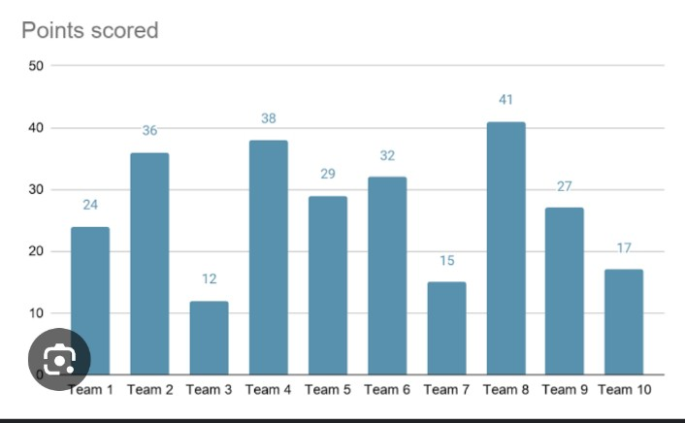
RESULTS
11

Slide 12
conclusion
1. Improved internal equity and fairness
2. Enhanced external competitiveness
3. Better talent attraction and retention
4. Compliance with regulations (e.g., equal pay laws)
5. Data-driven decision-making
6. Increased employee satisfaction and engagement

